Slide 1
Enhanced Engineering Workflows in the HPCMP CREATETM Ecosystem Demonstrated on the SUI Endurance UAV
Jennifer Abras, Vinod Lakshminarayan, Eric Mestreau, Saikat Dey, and Nathan Hariharan
Overset Grid Symposium, September 2026

Slide 2
Distribution Statement A. Approved for public release: distribution is unlimited.
Motivation
Days - Weeks
Geometry Processing
Grid Generation
Simulation
Time
Total time needed to get to the start of running simulations may span from days to weeks depending on the size and complexity of a configuration
Adopting methods to reduce the time spent prior to simulation execution saves a significant amount of time

Slide 3
Generic Engineering Workflow
Distribution Statement A. Approved for public release: distribution is unlimited.
Task Start Communication
Gather Information
Pre-Process Information
Generate Grids
Setup Simulation Inputs
Execute Simulations
Post-Process Results
Report Generation
Task End Communication
Notes:
I am going to start with this generic simulation-centric engineering workflow. The simulation specific tasks are represented by the dark red boxes, which influence the pre and post processing of information going into and coming out of the software. Which in turn influence the gathering and reporting of information. Thus, the simulation tasks influence the entire workflow to varying degrees.

Slide 4
Toolset for the Current Investigation
Distribution Statement A. Approved for public release: distribution is unlimited.
Task Start Communication
Gather Information
Pre-Process Information
CREATETM Capstone
HIGen GUI
CREATETM-AV Helios
Post-Process Results
Report Generation
Task End Communication
Notes:
CREATE has a wide variety of tools available including tools for both fixed and rotary wing air vehicles, design, surrogate modeling, ships, RF, ground vehicles and grid generation. In the current effort I am focusing on Capstone and Helios which are the grid generation and rotary wing air vehicle software packages.

Slide 5
Toolset for the Current Investigation
Distribution Statement A. Approved for public release: distribution is unlimited.
Task Start Communication
Gather Information
Pre-Process Information
CREATETM Capstone
HIGen GUI
CREATETM-AV Helios
Post-Process Results
Report Generation
Task End Communication
Notes:
Specifically we will be looking at the relation between these three items and how recent features can save time in the workflow.

Slide 6
Specific Features Demonstrated
Distribution Statement A. Approved for public release: distribution is unlimited.
Shrink-Wrapping
Pre-Process Information
CREATETM Capstone
Auto-Meshing
CREATETM-AV Helios
GPU Execution
Notes:
The features discussed are shrink-wrapping which reduces the Pre-Processing time, auto-meshing which reduces the time spent in grid generation, and GPU execution which reduces the simulation wall time

Slide 7
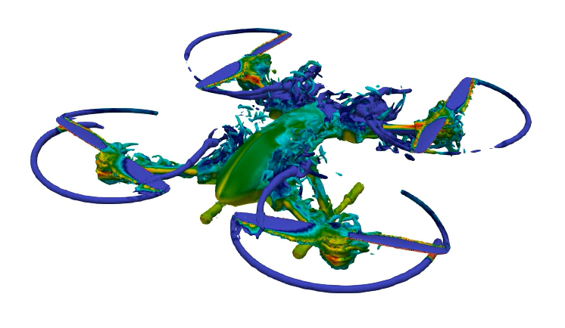
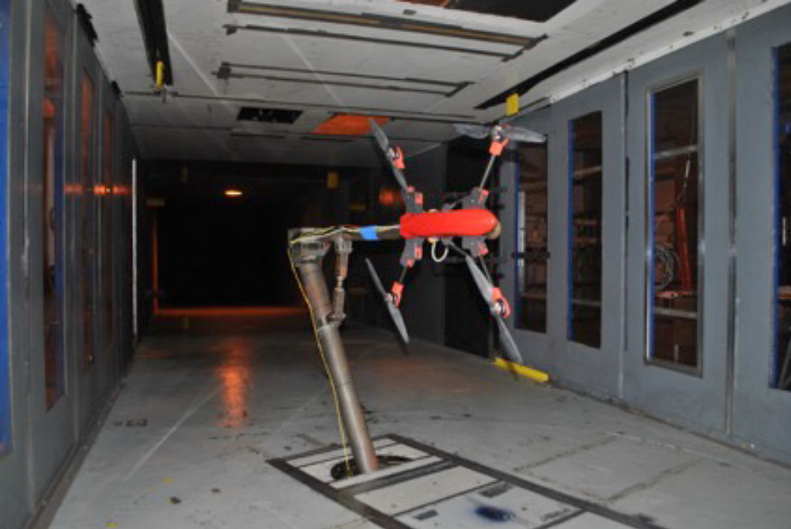
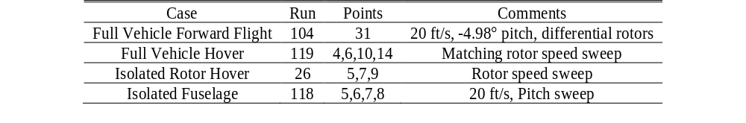
SUI Endurance Quadcopter
Distribution Statement A. Approved for public release: distribution is unlimited.
“Wind Tunnel and Hover Performance Test Results for Multicopter UAS Vehicles”
NASA-TM-2018-219758
U.S. Army 7- by 10-ft Wind Tunnel at NASA Ames Research Center

Slide 8
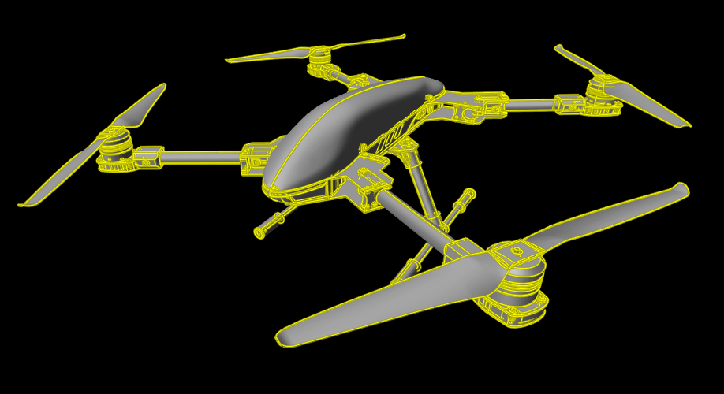
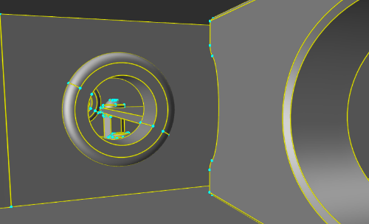
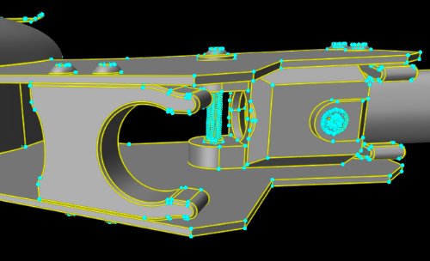
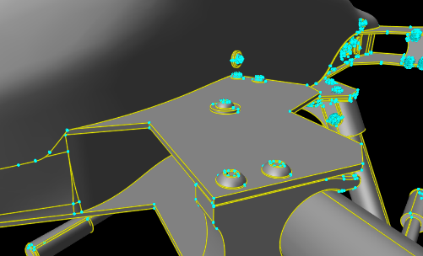
Methodology: Raw CAD
Distribution Statement A. Approved for public release: distribution is unlimited.
Pre-Process Information
CREATETM Capstone
87,734 Faces
229,827 Edges
143,621 Vertices
CREATETM-AV Helios

Slide 9
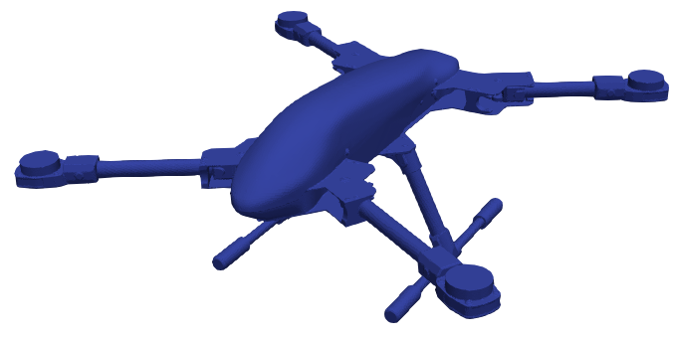
Capstone Methodology: Shrink-Wrapping
Distribution Statement A. Approved for public release: distribution is unlimited.
Pre-Process Information
CREATETM Capstone
CREATETM-AV Helios
Saves time because geometry does not need to be simplified or made watertight to generate a usable mesh

Slide 10
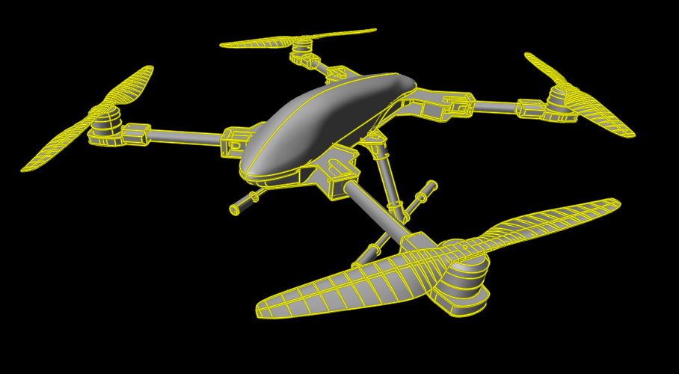
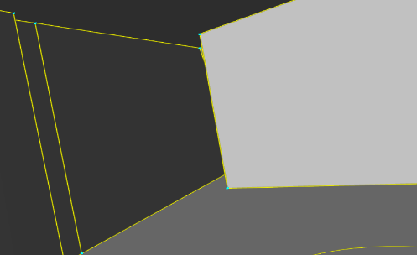
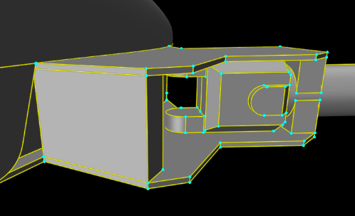
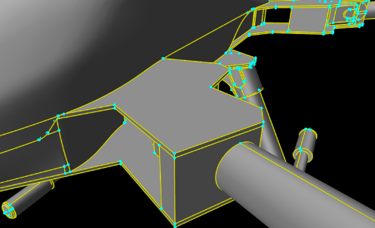
Methodology: Traditional Path, CAD Simplification
Distribution Statement A. Approved for public release: distribution is unlimited.
Pre-Process Information
CREATETM Capstone
1804 Faces
4303 Edges
2499 Vertices
CREATETM-AV Helios

Slide 11
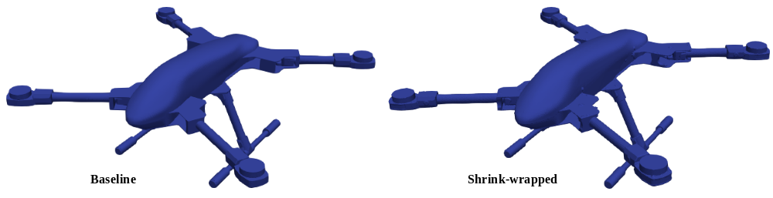
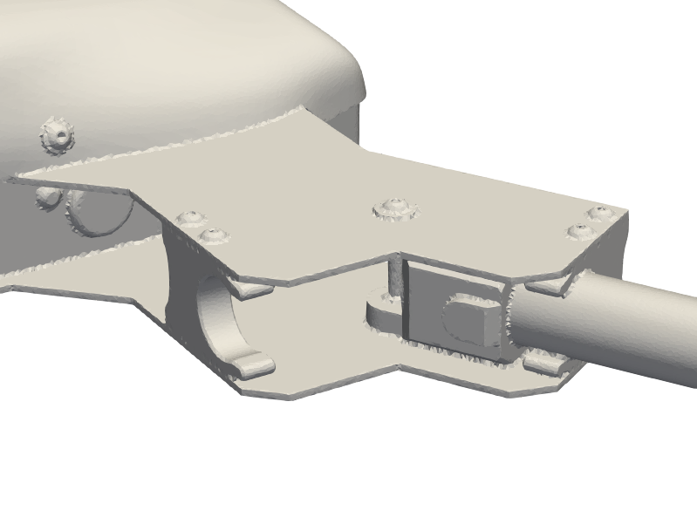
Methodology: Trade-off
Distribution Statement A. Approved for public release: distribution is unlimited.
Single surface patch
Less control over the sizing field
Small details are washed out
Shrink-wrapping takes time, but is hands off
Pre-Process Information
CREATETM Capstone
CREATETM-AV Helios

Slide 12
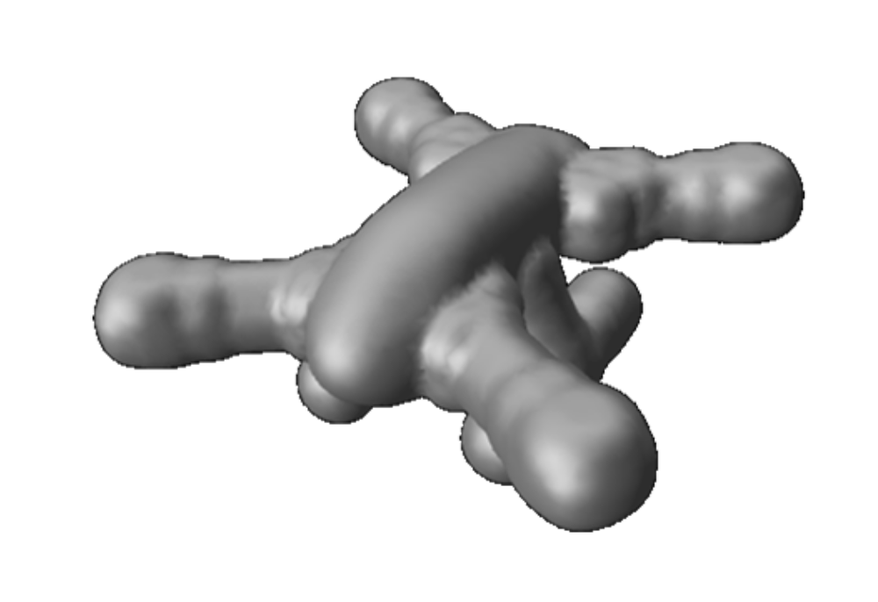
Methodology: Outer Surface
Distribution Statement A. Approved for public release: distribution is unlimited.
Pre-Process Information
CREATETM Capstone
CREATETM-AV Helios

Slide 13
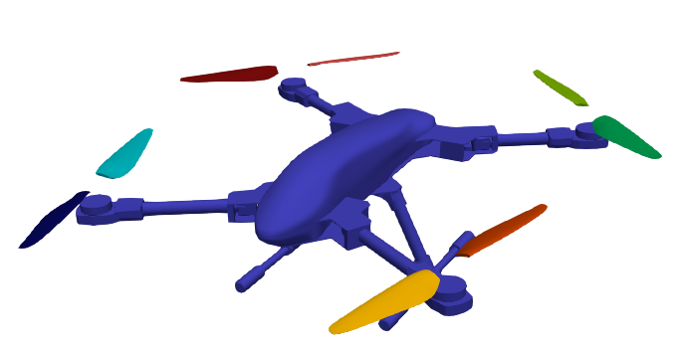
Helios Methodology: Auto-Meshing
Distribution Statement A. Approved for public release: distribution is unlimited.
Pre-Process Information
CREATETM Capstone
CREATETM-AV Helios
Provide geometry directly to Helios, sizing field is automatically determined, mesh generated at runtime
Saves time by eliminating the iterative process associated with manual sizing field setup and grid generation

Slide 14
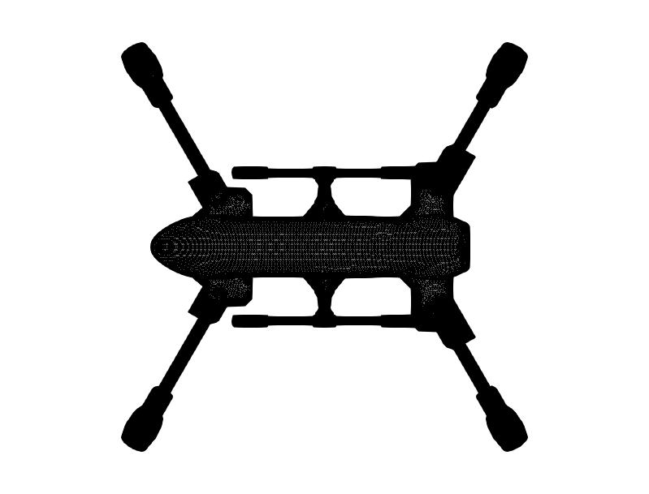
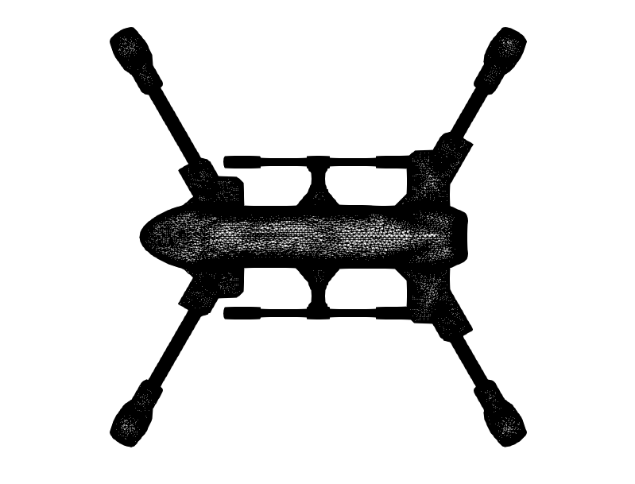
Methodology: Auto-Meshing (Fuselage)
Distribution Statement A. Approved for public release: distribution is unlimited.
Baseline
Auto-Meshed
Pre-Process Information
CREATETM Capstone
CREATETM-AV Helios
New feature of auto-meshing generates fully-unstructured volume meshes

Slide 15
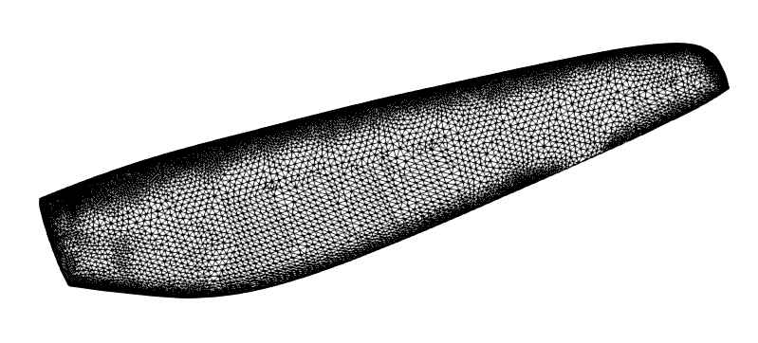
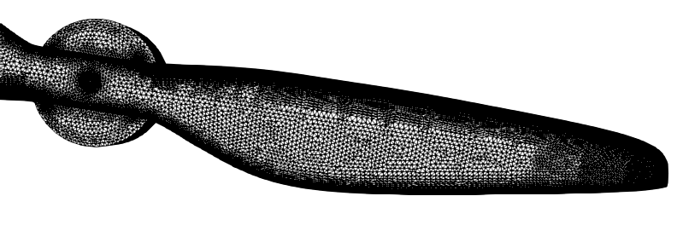
Methodology: Auto-Meshing (Blades)
Distribution Statement A. Approved for public release: distribution is unlimited.
Auto-Meshed
Pre-Process Information
New feature of auto-meshing uses edge detection to refine the surface
CREATETM Capstone
Baseline
CREATETM-AV Helios

Slide 16
Methodology: Auto-Meshing (Blades)
Distribution Statement A. Approved for public release: distribution is unlimited.
Trade-off
  Saves time spent manually setting up the sizing field
  Parameterized sizing field eliminates fine control over the grid distribution
Auto-Meshed
Pre-Process Information
CREATETM Capstone
Baseline
CREATETM-AV Helios

Slide 17

Methodology: Helios 12.5 GPU Beta
Distribution Statement A. Approved for public release: distribution is unlimited.
Domain Connectivity
Pre-Process Information
Unstructured Near-Body Solver
Cartesian
Off-Body Solver
PUNDITG
Rapidus
Orchard
CREATETM Capstone
CREATETM-AV Helios
use_gpu = “yes”

Slide 18
Methodology: Helios 12.5 GPU Beta
Distribution Statement A. Approved for public release: distribution is unlimited.
Domain Connectivity
Pre-Process Information
Immersed Boundary Method
Cartesian
Off-Body Solver
PUNDITG
ROAM
Orchard
CREATETM Capstone
CREATETM-AV Helios
use_gpu = “yes”

Slide 19
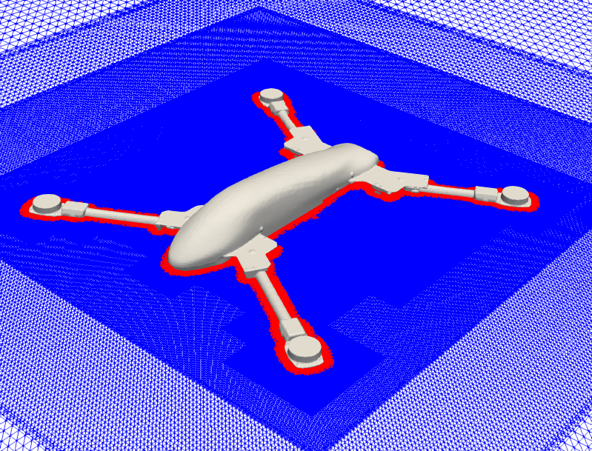
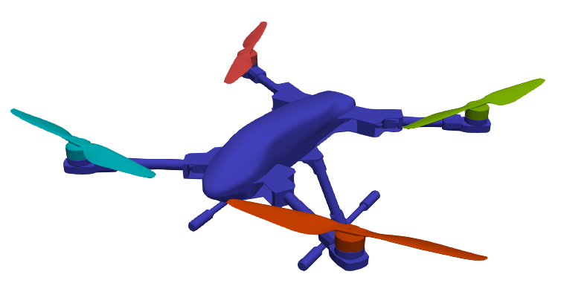
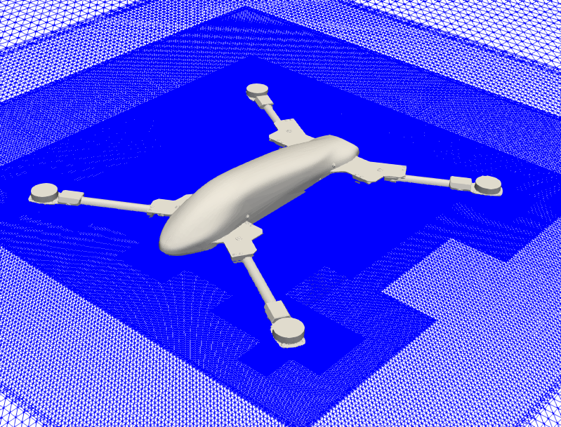
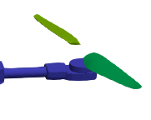
Baseline Computational Setup
Distribution Statement A. Approved for public release: distribution is unlimited.
Rapidus/Orchard
ROAM/Orchard
Auto-Mesh Variation

Slide 20
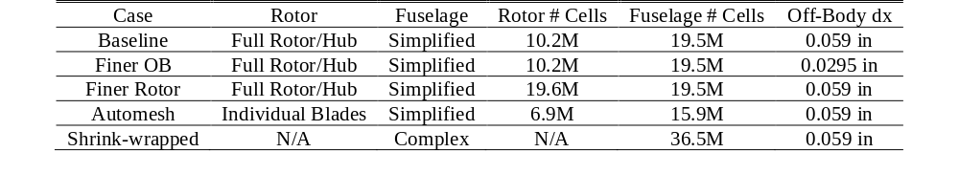
Baseline Computational Setup
Distribution Statement A. Approved for public release: distribution is unlimited.
Rapidus/Orchard
ROAM/Orchard
5% chord
Auto-Mesh Variation
2.5% chord

Slide 21
Full Vehicle Forward Flight
Distribution Statement A. Approved for public release: distribution is unlimited.
Results

Slide 22
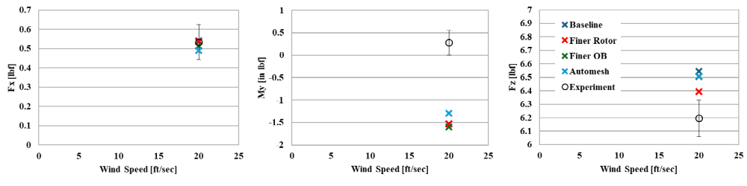
Full Vehicle Integrated Forces and Moments
Distribution Statement A. Approved for public release: distribution is unlimited.
< 6% Error
The F_{x} and F_{z} results are ok, but the M_{y} results require deeper investigation

Slide 23
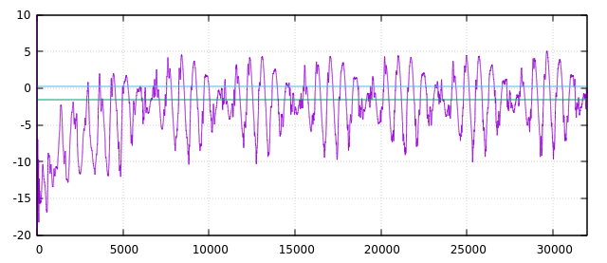
Full Vehicle Pitching Moment Time-History
Distribution Statement A. Approved for public release: distribution is unlimited.
My [in lbf]
Iteration
The M_{y} error seems significant, but the time-history reveals the test data are well within in the unsteady min/max range of the simulation

Slide 24
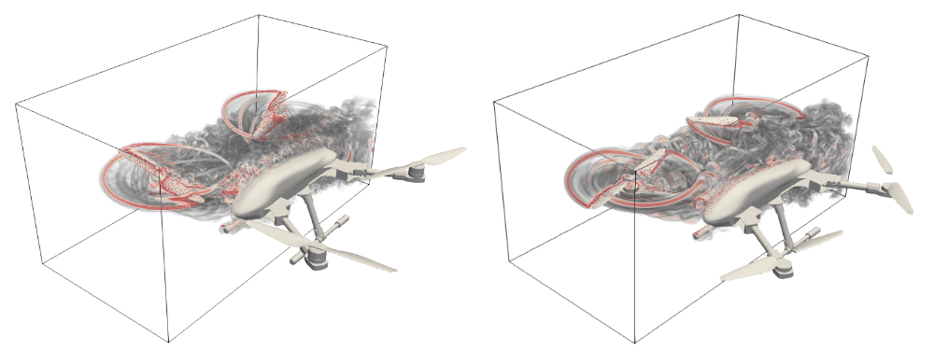
Auto-Mesh Assessment
Distribution Statement A. Approved for public release: distribution is unlimited.
Auto-mesh results are comparable to baseline

Slide 25
Isolated Fuselage
Distribution Statement A. Approved for public release: distribution is unlimited.
Results

Slide 26
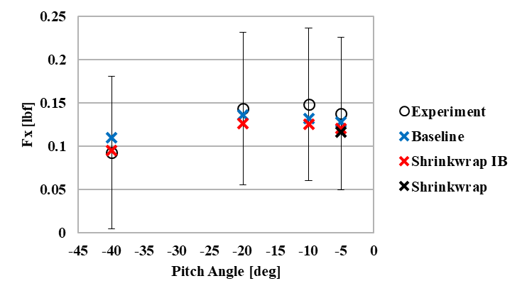
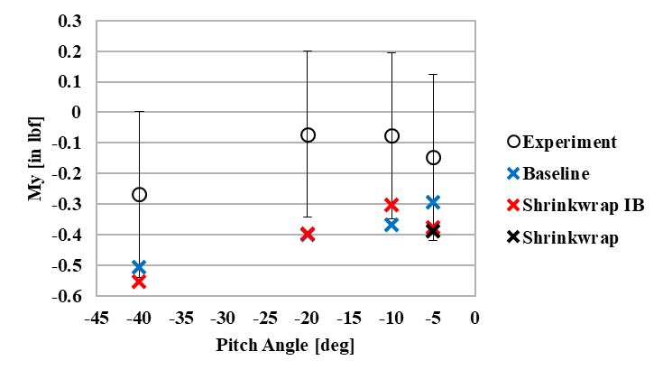
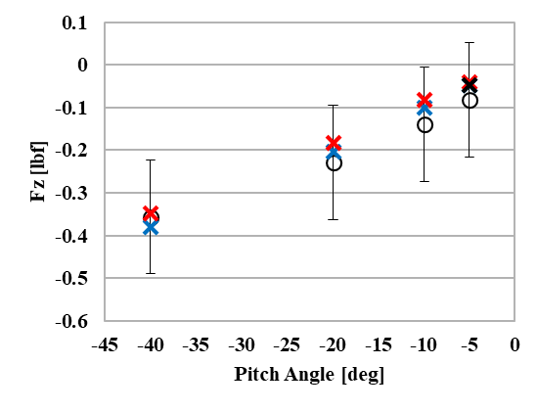
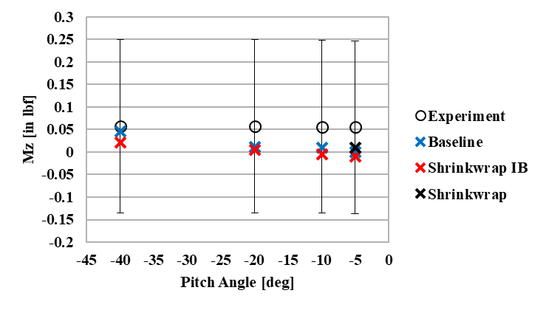
Integrated Forces and Moments
Distribution Statement A. Approved for public release: distribution is unlimited.

Slide 27

Shrink Wrap Geometry Delta
Distribution Statement A. Approved for public release: distribution is unlimited.
Geometric differences between the models are not a significant factor

Slide 28
Shrink Wrap Assessment
Distribution Statement A. Approved for public release: distribution is unlimited.
Shrink-wrapped immersed boundary and shrink-wrapped full volume meshed results are both comparable to baseline

Slide 29
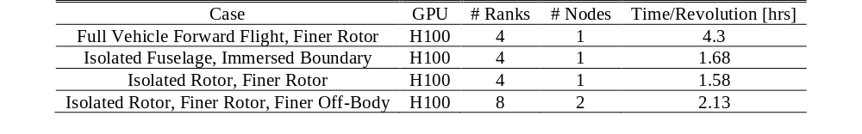
Helios Computational Metrics
Distribution Statement A. Approved for public release: distribution is unlimited.
2 hrs/rev is a reasonable expectation for a well refined setup run on GPUs
10 hrs/rev is typical for the matching CPU driven simulations
When run on 8 H100s (2 nodes) this simulation takes about 2.2 hrs/rev

Slide 30
Total Workflow Time Savings
Distribution Statement A. Approved for public release: distribution is unlimited.
Geometry Processing
Grid Generation
Simulation
Total Time
Traditional/Baseline
4 days
2 days
CPU: 4 days
10 days
Auto-Meshing
4 days
CPU: 4 days
8 days
Shrink-wrapping (Volume)
5 h
CPU: 4 days
4 days
Shrink-wrapping (Volume) + GPU Execution
5 h
GPU: 20 hrs
1 day
Shrink-wrapping (Immersed Boundary) + GPU Execution
2
6 hrs
8 hrs
Shrink-wrapping (Immersed Boundary) + GPU Execution + 10% chord engineering fidelity
2
2
4 hrs
Notes:
Assumptions: 2 H100 nodes, 10 rev equivalent simulation timeframe, engineering fidelity 10% chord/1 deg step size, CPU 10 hrs/rev, GPU 2 hrs/rev

Slide 31
Conclusions
Distribution Statement A. Approved for public release: distribution is unlimited.
Geometry Processing
Grid Generation
Simulation
Total Time
Traditional/Baseline
4 days
2 days
CPU: 4 days
10 days
Auto-Meshing
4 days
CPU: 4 days
8 days
Shrink-wrapping (Volume)
5 h
CPU: 4 days
4 days
Saved time in the overall workflow and predicted comparable results
Shrink-wrapping (Volume) + GPU Execution
5 h
GPU: 20 hrs
1 day
Shrink-wrapping (Immersed Boundary) + GPU Execution
2
6 hrs
8 hrs
Shrink-wrapping (Immersed Boundary) + GPU Execution + 10% chord engineering fidelity
2
2
4 hrs

Slide 32
Acknowledgements
Distribution Statement A. Approved for public release: distribution is unlimited.
Material presented is a product of the CREATE (Computational Research and Engineering for Acquisition Tools and Environments) element of the U.S. Department of Defense HPC Modernization Program. In addition, the authors would like to acknowledge the support of the supercomputing resources provided by the HPCMP.
The authors would also like to acknowledge the contributions of Dr. Robert Narducci who simplified the CAD model used in this effort.

Slide 33
Isolated Rotor in Hover
Distribution Statement A. Approved for public release: distribution is unlimited.
Results

Slide 34
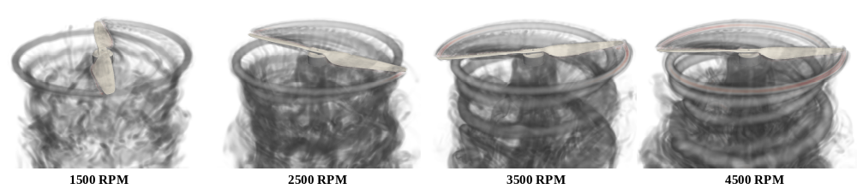
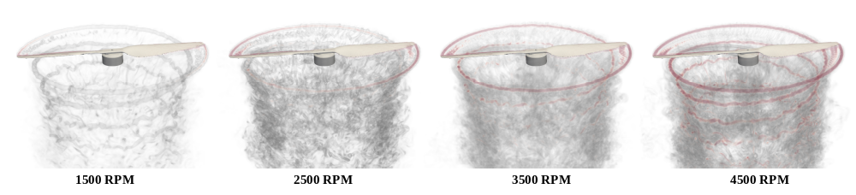
Setup and Wake Geometry
Distribution Statement A. Approved for public release: distribution is unlimited.
5% Chord
2.5% Chord

Slide 35
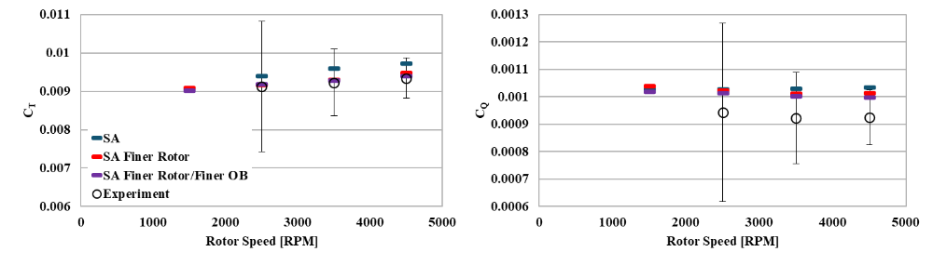
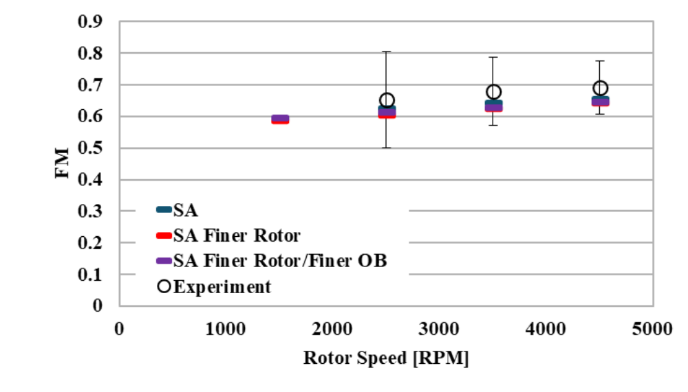
Coefficient Forces and Moments
Distribution Statement A. Approved for public release: distribution is unlimited.

Slide 36
Full Vehicle Hover
Distribution Statement A. Approved for public release: distribution is unlimited.
Results

Slide 37
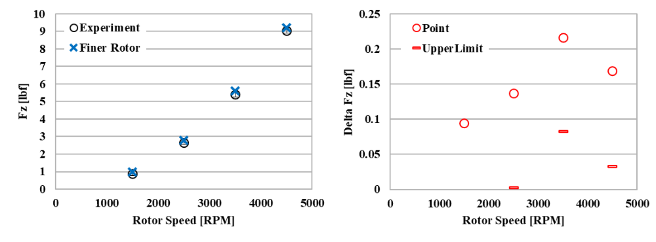
Full Vehicle Vertical Force
Distribution Statement A. Approved for public release: distribution is unlimited.
< 5% Error

Slide 38
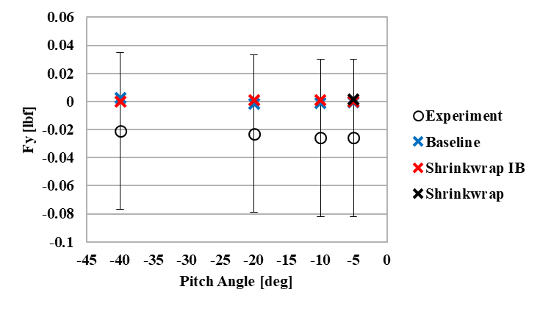
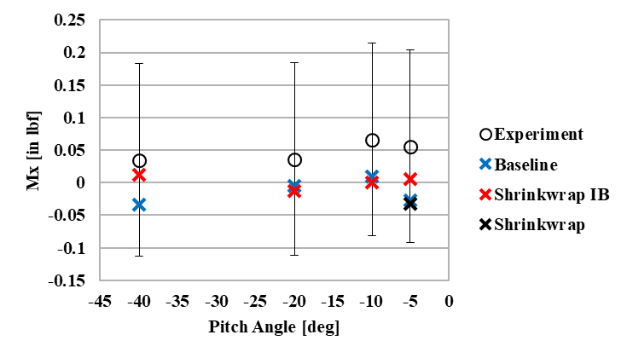
Isolated Fuselage: Integrated Forces and Moments
Distribution Statement A. Approved for public release: distribution is unlimited.

